Slide 1
Introduction to Web Development
By Brian MacMillan version 2017-01-29

Slide 2
Web sites typically have three tiers
Front end
Web browser
Scripting languages, particularly javascript (ECMA script)
Back end
Web server, for example Apache, Websphere, IIE, which handles requests for documents
Database server, for example MySQL, Oracle, MS SQL Server, Mongo, which handle requests for data
Middle Tier
Controlling programs that coordinate communication between the backend and the front end
Java
Python
PHP

Slide 3
Important web protocols and standards
HTTP
Hypertext transfer protocol
HTTPS
Secure hypertext transfer protocol
HTML
A series of standards, defined by the W3C consortium, that govern how web documents are formatted
Current implementation is HTML5
HTML documents are a subset of the XML (extensible markup language)
Highly structured. All data is contained in elements that are delineated by paired tags
<html><head></head><body></body></html>

Slide 4
Important web protocols and standards (continued)
Cascading Style Sheets (CSS)
A series of formatting instructions that are applied to HTML documents
Design is separate from content
Standard also managed by the W3C organization

Slide 5
Simple HTML document
<!DOCTYPE html>
<html>
<head>
<meta content="text/html; charset=utf-8" http-equiv="Content-Type">
<link media="screen" rel="stylesheet" href=“sample.css" type="text/css">
</head>
<body>
<div>
</div>
</body>
</html>

Slide 6
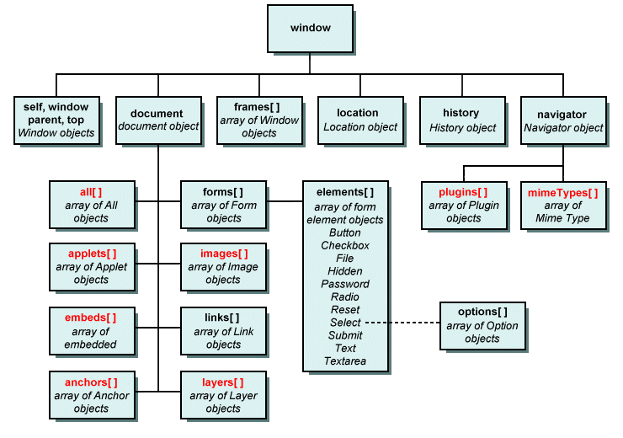
Document Object Model: DOM
Application programming interface (API)
for manipulating html, xml and svg documents.
See also:
https://developer.mozilla.org/en-US/docs/Web/API/Document_Object_Model
Image source: http://www.technologyuk.net/the_internet/web/document_object_model.shtml

Slide 7
Cascading Style Sheets
Separate content from layout
See: http://csszengarden.com
Uses selection criteria based on position in document hierarchy, element type, class and / or element id to format elements.

Slide 8
SIMPLE CSS Document
body{background-color:red;} /* element */
#main{color:purple;} /* element id */
.body-text{font-family:serif;} /* class */

Slide 9
Changing Elements VIA ID
<!DOCTYPE html>
<html>
<head>
<meta content="text/html; charset=utf-8" http-equiv="Content-Type">
<link media="screen" rel="stylesheet" title=“sample.css" href=“style.css" type="text/css">
</head>
<body>
<div id=“main”>This is content in an element named main
</div>
</body>
</html>

Slide 10
Changing Elements via class
<!DOCTYPE html>
<html>
<head>
<meta charset="utf-8">
<title>Simple Cascading Example</title>
<link href="style_cascading.css" rel="stylesheet">
</head>
<body>
<p id="first-paragraph" class="header" class=“body-text”>Paragraph One</p>
<p class=“body-text”>Paragraph Two</p>
<p class=“body-text”>Paragraph Thre</p>
<p class=“”>Paragraph Three</p>
<p class=“”>Paragraph Four</p>
<div>This is a child</div>
<div><div>This is a grandchild</div></div>
</body>
</html>

Slide 11
How Does css handle conflicts?
body {color:red;}
.body-text{font-family:serif;font-size:12pt;}
p{font-family:serif;font-weight:bold}
#first-paragraph{font-family:sans-serif;font-size:20pt;font-weight:normal;}dy
body div {background-color: salmon;}
body > div {background-color: yellow;}

Slide 12
Inheritance: Why is the text All RED?
Many attributes of parent elements, for example color and alignment, are inherited by children. Setting the color of the body element to red causes all elements contained by <body> to become red.
Body{color: red}

Slide 13
Cascading: selecting children
Attributes of parent elements are often, not always, inherited by children.

Slide 14
Cascading: selecting immediate children
To select the immediate children of an element use the > operator. The following example will select the li children of ul. It will not select grandchildren. This is very important when you have many layers of nested elements.
ui > li

Slide 15
Cascading: resolution of conflicts
General to specific
Elements are most general
Classes are the next most detailed
Ids are the most specific

Slide 16
Display: Block, Inline, None
Block elements have a line feed before and after, inline elements do not.
Block elements have a height property
Inline elements have a line-height property, they do not have a width property

Slide 17
Inline elements
<abbr>, <acronym>,<b>, <big>, <button> <i>, <tt>,<cite>,
<code>, <input>, <label>, <script>, <select>, <small>,<span>,<sub>,<sup><textarea>
See https://developer.mozilla.org/en-US/docs/Web/HTML/Inline_elemente for details.

Slide 18
Block elements
<p>,<h1>,<h2>, <h3>, <h4>, <h5>, <h6>, <ul>, <ol>, <dl>, <pre>, <hr>, and <address>,<article>,<aside>,<blockquote><canvas>,<dd>,<div>,<dl>,<figure>, <figcaption>,<fieldset>,<footer>,<form>,<header>,<hgroup>,<hr>, <,nav> <noscript>,<ol>,<output>,<pre>,<section><table>,<tfoot><video>,
See https://devoper.mozilla.org/en-US/docs/Web/HTML/Block-level_elements

Slide 19
Inline versus block example
inline_versus_block_example.html

Slide 20
Positioning
Style | Description
Position: static | Default value. Elements render in order, as they appear in the document flow
Position: absolute | The element is positioned relative to its first positioned (not static) ancestor element
Fixed | The element is positioned relative to the browser window
Position: relative | The element is positioned relative to its normal position, so "left:20" adds 20 pixels to the element's LEFT position
Position: initial | Sets this property to its default value. Read about initial
Position :inherit | Inherits this property from its parent element. Read about inherit

Slide 21
Display Inline-Block
Block elements can be given the inline-block display style, which allows them to be placed side by side in a line, while also allowing height property to be set.

Slide 22
Inline block example

Slide 23
Fixed Layouts
“A fixed website layout has a wrapper that is a fixed width, and the components inside it have either percentage widths or fixed widths. The important thing is that the container (wrapper) element is set to not move. No matter what screen resolution the visitor has, he or she will see the same width as other visitors.”
http://www.smashingmagazine.com/2009/06/fixed-vs-fluid-vs-elastic-layout-whats-the-right-one-for-you/

Slide 24
Fixed Layout Pros and Cons
Pros
Fixed-width layouts are much easier to use and easier to customize in terms of design.
Widths are the same for every browser, so there is less hassle with images, forms, video and other content that are fixed-width.
There is no need for min-width or max-width, which isn’t supported by every browser anyway.
Even if a website is designed to be compatible with the smallest screen resolution, 800×600, the content will still be wide enough at a larger resolution to be easily legible.
Cons
A fixed-width layout may create excessive white space for users with larger screen resolutions, thus upsetting “divine proportion,” the “Rule of Thirds,” overall balance and other design principles.
Smaller screen resolutions may require a horizontal scroll bar, depending the fixed layout’s width.
Seamless textures, patterns and image continuation are needed to accommodate those with larger resolutions.
Fixed-width layouts generally have a lower overall score when it comes to usability.

Slide 25
LIquid Layout
All containers on the page have their widths defined in percents – meaning that they are completely based on the viewport rather than the initial containing block. A liquid layout will move in and out when you resize your browser window
Layout changes according to the width of browser resolution, and resolution of screen
Most container elements have percentage widths
Example:
http://brianmacmillan.com/il/index.html

Slide 26
Liquid Layout pros and cons
Pros Link
Fluid web page design can be more user-friendly, because it adjusts to the user’s set up.
The amount of extra white space is similar between all browsers and screen resolutions, which can be more visually appealing.
If designed well, a fluid layout can eliminate horizontal scroll bars in smaller screen resolutions.
Cons Link
The designer has less control over what the user sees and may overlook problems because the layout looks fine on their specific screen resolution.
Images, video and other types of content with set widths may need to be set at multiple widths to accommodate different screen resolutions.
With incredibly large screen resolutions, a lack of content may create excess white space that can diminish aesthetic appeal.

Slide 27
Mixture of Liquid and Fixed Layouts
A liquid layout in which one or more of the containers on the page have fixed widths.

